Slide 1

PRE-IDEATHON TEMPLATE
GENESIS
IDEATHON
HUSTLERS & ENERGY,MOBILTY AND SMART INFRASTRUCTURE
Team Name –HUSTLERS
Team Members –RK Pranesh,Gautham S,Nithiswar MR,Pragadeesh NM
Selected Domain –Energy,mobility and smart infrastucture
Problem Statement –Provision of efficient electricity in rural regions through hybrid microgrid model

Slide 2


DOMAIN PROBLEM IN OUR WORDS
TEAM
Hustlers
Explain the problem in your domain simply, in your own words
What exactly needs to be solved?
Unreliable electricity supply and frequent power outages in villages
Dependence on diesel generators during power cuts
High electricity and fuel costs
Insufficient power for agriculture, businesses, schools, and healthcare
Underutilization of local renewable resources such as solar, hydro, and biogas
Lack of a reliable, integrated local energy system
Energy losses and inefficiency in the existing supply system
Core problem:
Villages need a reliable, affordable, and sustainable electricity supply that can meet both household and productive energy needs.
Why is it important right now?
Growing electricity demand in rural areas due to increasing use of appliances, irrigation, and small industries.
Frequent power interruptions can disrupt education, healthcare, agriculture, and businesses.
Rising fuel costs make dependence on diesel generators expensive.
Renewable energy is becoming more accessible, making village-scale microgrids increasingly practical.
Climate change increases the need for cleaner and more resilient energy systems.
Local resources such as solar, water, and organic waste are often available but underutilized.
Rural economic development requires reliable electricity for new businesses, digital services, and productive activities.
Key message:
“The need for reliable rural electricity is growing, while renewable technologies now provide an opportunity to build cleaner and more resilient local power systems.”

Slide 3
WHO IS AFFECTED?
TEAM
Hustlers
Target users, stakeholders, beneficiaries
Who benefits if the problem is solved?
Primary Users / Target group
Village Residents & Farmers
Village Panchayat / Local Government
Electricity Utility (DISCOM)
Government & Funding Agencies
Technology & EPC Companies
Local Operators & Maintenance Teams
Local Businesses & Institutions
Banks & Financial Institutions
NGOs / Community Organizations
Environmental & Regulatory Authorities
Secondary stakeholders
NGOs & Community Organizations
Banks & Financial Institutions
Equipment Suppliers
Research & Academic Institutions
Environmental Agencies
Regulatory Authorities
Insurance Companies
Waste Management Organizations
Training & Skill Development Organizations
Local Transport & Logistics Providers
Village Residents & Families
Farmers
Students & Schools
Healthcare Centres & Patients
Local Businesses & Entrepreneurs
Village Panchayat / Local Government
Micro & Small Industries
Agricultural & Dairy Cooperatives
Environment & Local Ecosystem
Future Generations

Slide 4
CURRENT SITUATION & CONTEXT
TEAM
Hustlers
Existing scenario, background and how things work today
Existing scenario and background
Many villages face unreliable electricity, frequent power cuts, high energy costs, and limited access to dependable power for agriculture, education, healthcare, and small businesses.
At the same time, villages may have locally available renewable energy resources, such as sunlight, flowing water, and organic waste from cattle and agricultural activities.
The proposed solution is to develop an integrated renewable energy microgrid that combines solar, micro-hydro, biogas, biodiesel backup, battery storage, and a smart control system to provide a more reliable and sustainable electricity supply.
Relevant data or facts (if available)
Problem: Rural villages faced unreliable electricity, affecting households and small businesses.
Solution: Founded in 2007, Husk Power Systems used rice husks to generate electricity. It later introduced solar-biomass hybrid microgrids.
Impact: The project improved rural electricity access, utilized agricultural waste, and supported local businesses.
Connection to Our Project: Our proposed microgrid combines solar, hydro, biogas, battery storage, and biodiesel backup to provide more reliable village electricity.
Key Learning: Local resources can be transformed into reliable energy to support rural development.
Current workflow, step by step

Slide 5
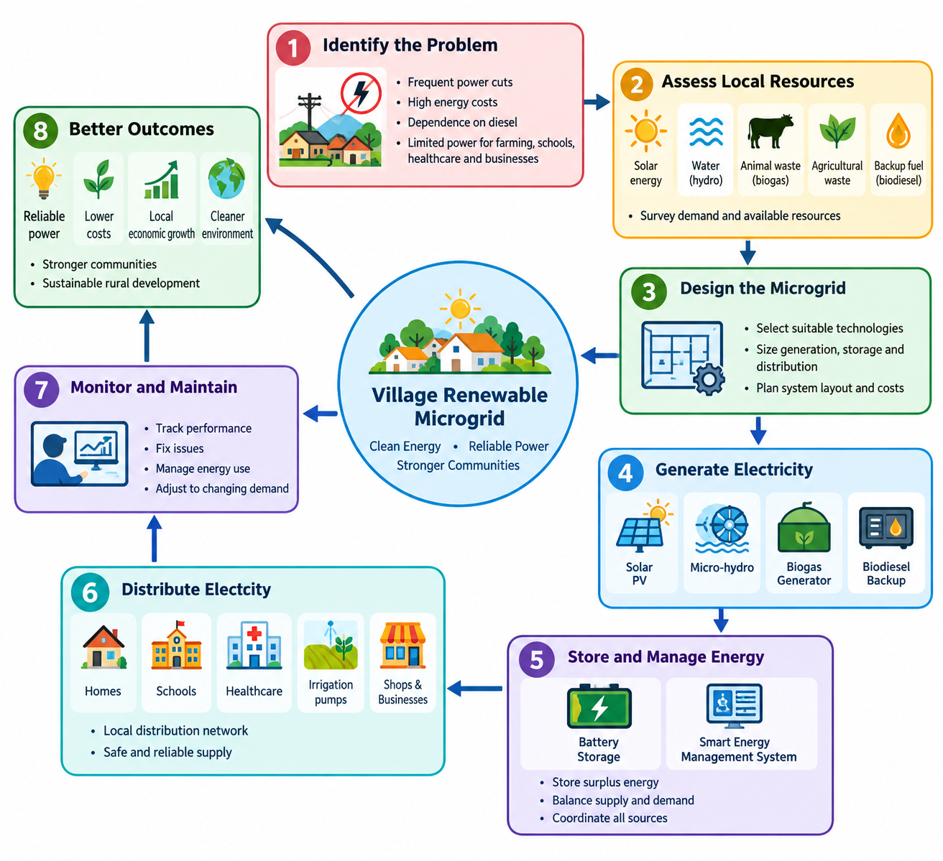
Current workflow, step by step

Slide 6
KEY CHALLENGES
TEAM
Your Team Name
Main difficulties, bottlenecks, root causes and consequences
Unpredictable Energy: Solar and hydro power depend on weather and water availability, while biogas and biomass need a steady fuel supply.
Low Piezoelectric Output: Piezoelectric generators produce very little electricity, making them suitable mainly for sensors and small devices.
High Costs: Batteries, generators, inverters, and installation require significant initial investment.
Technical Challenges: Integrating different energy sources requires smart control systems, skilled operators, and regular maintenance.
Possible Solutions: Combine suitable renewable sources with battery storage, efficient energy management, local training, and careful planning.
Root causes behind them
Resource Dependence: Solar energy varies with sunlight, hydro depends on water flow, and biogas/biomass require available organic waste.
Low Energy Conversion: Piezoelectric generators produce limited electricity because everyday pressure and vibrations contain relatively little usable energy.
High Initial Investment: Renewable generators, batteries, inverters, and distribution networks require substantial funding.
Technical Limitations: Poor system design, limited storage capacity, and inadequate energy management can cause unreliable power supply.
Infrastructure and Skills Gaps: Lack of trained technicians, maintenance facilities, reliable fuel supply chains, and community awareness can hinder successful operation.

Slide 7
Consequences of leaving them unsolved
Unreliable Electricity: Frequent power cuts affect homes, schools, and healthcare centres.
Economic Losses: Farmers and local businesses experience reduced productivity and income.
Higher Energy Costs: Continued dependence on diesel and other fuels increases operating expenses.
Limited Renewable Energy Use: Local resources remain underutilized, increasing pollution and environmental impacts.
Slower Rural Development: Poor electricity access limits education, healthcare, job opportunities, and overall village development.

Slide 8
EXISTING SOLUTIONS / APPROACHES
TEAM
HUSTLERS
What is already being done, and where it falls short
EXISTING SYSTEMS
Integrated Solar–Micro-Hydro–Biogas Microgrid - Researchers studied an off-grid system combining solar PV, micro-hydro, biogas, batteries, and diesel backup for five villages in Uttarakhand, India. b
Tata Power Solar–Bio-CNG Microgrid, Paska, Uttar Pradesh - Announced in April 2026, this initiative combines solar power with bio-CNG- based energy solutions for rural electricity needs.
Limitations of each
Limited technology diversity: The announced solution focuses on solar and bio-CNG rather than integrating multiple locally suitable sources, such as micro-hydro.
Site-specific resource requirements: The proposed hydrokinetic turbine depends on a substantial, continuously flowing stream; its results cannot automatically be applied to a low-flow well-water pipe.
The gap they leave open (Key Challenges)
Limited Resource Integration: Some projects rely on a narrower combination of energy sources, leaving opportunities to evaluate other locally available renewable resources.
Seasonal Energy Reliability: Solar, hydro, and biomass availability can vary seasonally, making continuous electricity supply challenging.

Slide 9
PROBLEM INSIGHTS & OPPORTUNITY AREAS
TEAM
HUSTLERS
Resources required to solve the problem
HARDWARE REQUIREMENTS
Solar PV panels - Generate electricity from sunlight.
Micro-hydro turbine and generator - Generate electricity from flowing water, if the water flow and available pressure or height difference are sufficient.
Biodiesel generator - Provide backup electricity when renewable generation is insufficient.
Battery storage system - Store excess electricity for use at night or during outages.
Charge controller and inverter - Regulate battery charging and convert DC electricity into AC power where required.
Distribution equipment - Cables, transformers where needed, circuit breakers, fuses, and meters to deliver electricity safely.
SOFTWARE REQUIREMENTS
MATLAB/Simulink-Simulate solar, hydro, biogas, battery storage, and overall microgrid performance.
HOMER Pro-Optimize energy sources, system sizing, operating costs, and feasibility.
Other resources (Including Human Resources)

Slide 10
INITIAL DIRECTION & EXPECTED OUTCOME
TEAM
Your Team Name
What Is Your Expected Outcome?
What Our Team Intends to Do- Develop an integrated renewable microgrid combining solar, micro-hydro, biogas, and biodiesel backup.- Implement smart energy management with battery storage.- Explore electricity generation from existing low-pressure water flow.- Design an affordable and sustainable solution for rural electrification.
What We Want to Improve- Reduce frequent power outages and dependence on diesel generators.- Improve coordination and efficiency of multiple renewable energy sources.- Optimize battery usage and minimize energy wastage.- Reduce operating costs and improve electricity reliability.
3. What Successful Improvement Should Achieve- Provide a more reliable and continuous electricity supply to villages.- Reduce fuel consumption and long-term energy costs.- Improve access to electricity for agriculture, education, healthcare, and businesses.- Develop a scalable, environmentally sustainable microgrid model for rural communities.

Slide 11
TEAM CONTRIBUTION
TEAM
Your Team Name
Who will handle which part of the execution
Team Member | Role | Responsibility in Execution
R K PRANESH | Role | What they will handle
M R NITISHWAR | Role | What they will handle
S Gautham | Role | What they will handle
N M PRAGADEESH | Role | What they will handle

